Slide 1

Consumer Goods Ad-Hoc Insights

Slide 2

Company Overview
Atliq Hardwares (imaginary company) is one of the leading computer hardware producers operating in 26 countries, including India.
The company serves a diverse customer base of 36 clients across global and regional markets.
Products are manufactured under three major divisions: Peripherals & Accessories, PC, Networking & Storage.
Fiscal year of Atliq hardware starts from September to August.

Slide 3
Why?
The management noticed that they do not get enough insights to make quick and smart data-informed decisions.
They want to expand their data analytics team by adding several junior data analysts. Their data analytics director wanted to hire someone who is good at both technical and soft skills. Hence they decided to conduct an SQL challenge which will help them understand both the skills.
There are 10 ad hoc requests for which the business needs insights.

Slide 4
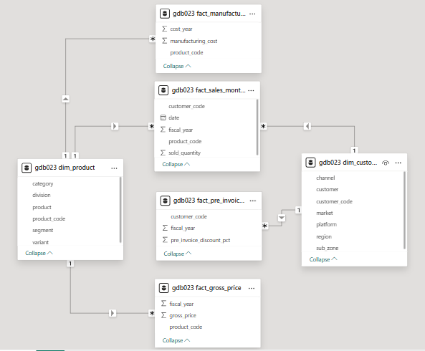
Data Model
Tables
Dimension Tables
dim_product
dim_customer
Fact Tables
fact_manufacturing_cost
fact_pre_invoice_deductions
fact_gross_price
fact_sales_monthly

Slide 5
List of markets in which customer "Atliq Exclusive" operates its business in the APAC region.
Request
Query
SELECT DISTINCT( market ) FROM dim_customer WHERE customer = 'Atliq Exclusive' AND region = 'APAC' ORDER BY market;

Slide 6
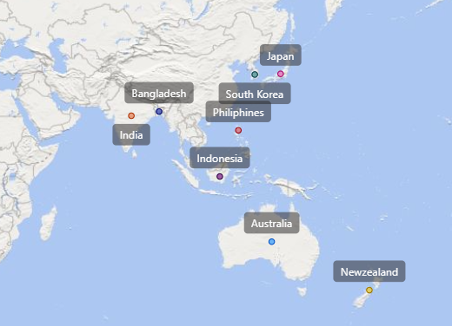


Slide 7
What is the percentage of unique product increase in 2021 vs. 2020?
Request
Query
SELECT cnt1 AS unique_products_2020, cnt2 AS unique_products_2021, ( cnt2 - cnt1 ) * 100 / cnt1 AS percentage_change FROM (SELECT Count(DISTINCT( product_code )) AS cnt1 FROM fact_sales_monthly WHERE fiscal_year = 2020) AS y_2020, (SELECT Count(DISTINCT( product_code )) AS cnt2 FROM fact_sales_monthly WHERE fiscal_year = 2021) AS y_2021;

Slide 8
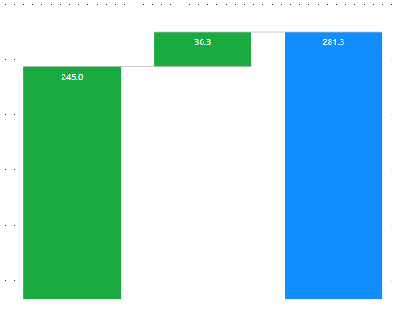

Change % = 36.33%
245
There was a 36.33% growth in the number of unique products from 2020 to 2021, indicating substantial expansion.
Unique products 2020
Unique products 2021

Slide 9
The unique product counts for each segment and sort them in descending order of product counts.
Request
Query
SELECT segment, Count(DISTINCT( product_code )) AS products_count FROM dim_product GROUP BY segment ORDER BY products_count DESC;

Slide 10
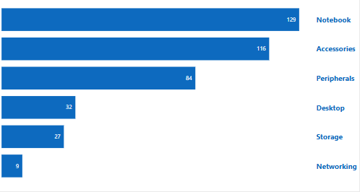
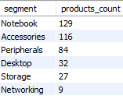
The Notebook category leads in performance with 129 units, followed closely by Accessories and Peripherals, indicating strong customer demand for portable and complementary tech products.
Desktop, Storage, and Networking categories show significantly lower engagement, approximately 17.13% of total product distribution.
This trend highlights opportunities to focus on high-performing segments while revitalizing underperforming ones.

Slide 11
Which segment had the most increase in unique products in 2021 vs 2020?
Request
Query
WITH cte1 AS ( SELECT segment, Count(DISTINCT(product_code)) AS 2020_cnt FROM dim_product JOIN fact_sales_monthly using (product_code) WHERE fiscal_year = 2020 GROUP BY segment),
cte2 AS ( SELECT segment, Count(DISTINCT(product_code)) AS 2021_cnt FROM dim_product JOIN fact_sales_monthly using (product_code) WHERE fiscal_year = 2021 GROUP BY segment) SELECT segment, 2021_cnt AS product_count_2021, 2020_cnt AS product_count_2020, 2021_cnt-2020_cnt AS difference FROM cte1 JOIN cte2 using (segment);

Slide 12
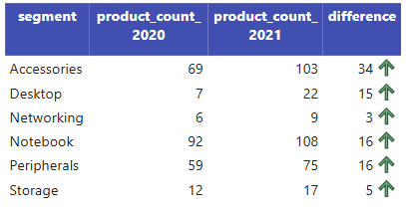
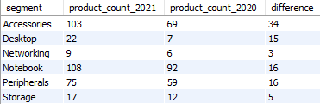
The data indicates consistent growth across all product segments from 2020 to 2021 with Accessories showing the biggest increase, while Storage and Networking also grew but from smaller numbers.
This suggests good potential to further develop Storage and Networking.
To boost sales, the business can promote these products through membership benefits or by bundling them with other tech items.

Slide 13
Get the products that have the highest and lowest manufacturing costs.
Request
Query
SELECT product_code, product, Round(manufacturing_cost, 2) AS manufacturing_cost FROM dim_product JOIN fact_manufacturing_cost using(product_code) WHERE manufacturing_cost IN (
SELECT Max(manufacturing_cost) FROM fact_manufacturing_cost UNION SELECT Min(manufacturing_cost) FROM fact_manufacturing_cost) ORDER BY product_code;

Slide 14

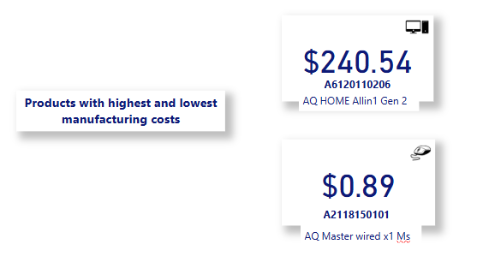

Slide 15
Top 5 customers who received an average high pre_invoice_discount_pct for the fiscal year 2021 and in the Indian market.
Request
Query
SELECT customer_code, customer, Round(Avg(pre_invoice_discount_pct) * 100, 2) AS average_discount_percentage FROM fact_pre_invoice_deductions JOIN dim_customer USING (customer_code) WHERE fiscal_year = 2021 AND market = 'India' GROUP BY customer_code ORDER BY average_discount_percentage DESC LIMIT 5;

Slide 16
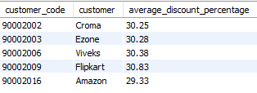
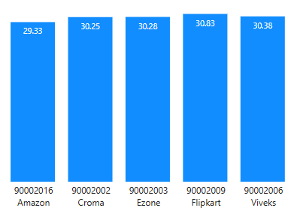
%
%
%
%
%
Flipkart has the highest average discount at 30.83%, followed closely by Viveks and Ezone.
Amazon gives the lowest average discount at 29.33%, possibly because of its strong brand and customer trust.
%

Slide 17
Gross sales amount for the customer “Atliq Exclusive” for each month.
Request
Query
SELECT Monthname(fsm.date) AS month, fsm.fiscal_year, Round(Sum(gross_price * sold_quantity)) AS total_gross_price FROM fact_sales_monthly AS fsm JOIN fact_gross_price using(product_code) JOIN dim_customer AS c ON c.customer_code = fsm.customer_code WHERE c.customer = 'Atliq Exclusive' GROUP BY Monthname(fsm.date), fsm.fiscal_year
ORDER BY total_gross_price desc;

Slide 18
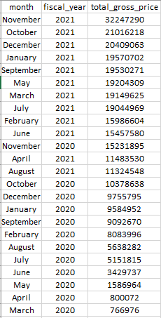
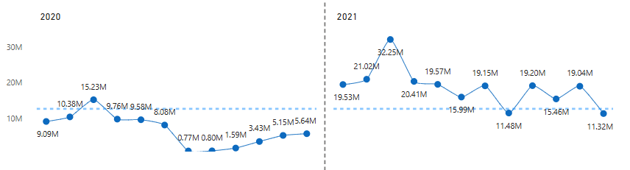
Sales increased significantly in Fiscal Year 2021 compared to the previous year.
The highest sales occurred in November 2020(fiscal year), showing a strong seasonal peak.
Sales dipped in March–May 2020 due to COVID and began recovering from June onward.

Slide 19
In which quarter of 2020, got the maximum total_sold_quantity?
Request
Query
SELECT Concat('Q', Quarter(Date_add(Date_format(DATE, '%Y-%m-01'), interval 4 month))) AS qrtr, SUM(sold_quantity) AS total_sold_quantity FROM fact_sales_monthly WHERE fiscal_year = 2020 GROUP BY qrtr ORDER BY total_sold_quantity DESC;

Slide 20

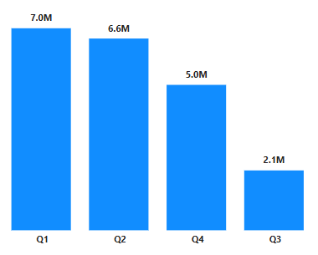
Q1 had the highest total sold quantity, indicating strong performance at the start of the year.
Q3 showed the weakest sales, with a significant drop compared to other quarters.
Sales picked up again in Q4, which could mean more people started buying or better planning helped boost sales at the end of the year.

Slide 21
Which channel helped to bring more gross sales in the fiscal year 2021 and the percentage of contribution?
Request
Query
WITH cte1 AS (
SELECT channel, Round(Sum(gross_price * sold_quantity) / 100000, 2) AS total_gross_price_mln FROM fact_sales_monthly AS fsm JOIN fact_gross_price using(product_code) JOIN dim_customer AS c ON c.customer_code = fsm.customer_code WHERE fsm.fiscal_year = 2021 GROUP BY channel)
SELECT channel, total_gross_price_mln, Round(( total_gross_price_mln * 100 / Sum(total_gross_price_mln) OVER() ), 2) AS percentage_contribution FROM cte1 GROUP BY channel;

Slide 22

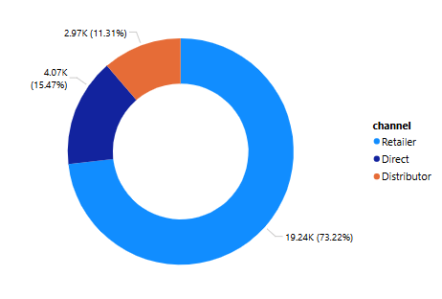
Major contribution is from the Retailer channel by 73.22%.
The distributor and the Direct channels lags behind by 11.31% and 15.47% respectively.
To boost the distributor engagement, regional promotions can be done.
Invest in digital marketing to drive traffic and improve customer retention

Slide 23
The top 3 products in each division that have a high total_sold_quantity in the fiscal_year 2021.
Request
Query
WITH cte1 AS (
SELECT division, product_code, Sum(sold_quantity) AS total_sold_quantity FROM dim_product JOIN fact_sales_monthly using (product_code) WHERE fiscal_year = 2021 GROUP BY division, product_code), cte2 AS (
SELECT division, product_code, total_sold_quantity, Dense_rank() OVER(partition BY division ORDER BY total_sold_quantity DESC ) AS drank FROM cte1)
SELECT division,product_code, total_sold_quantity FROM cte2 WHERE drank <= 3 ;

Slide 24
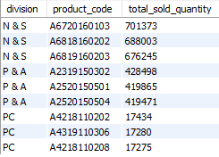
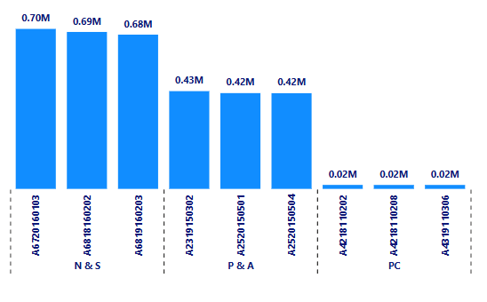
The N & S division has the highest total sold quantities, showing strong product demand compared to the others.
The top three best-selling products all belong to the N & S division, each selling over 670,000 units.
The PC division's sales are significantly lower, with each product selling under 18,000 units, indicating lower market performance or niche demand.

Slide 25
Thank you

